Slide 1
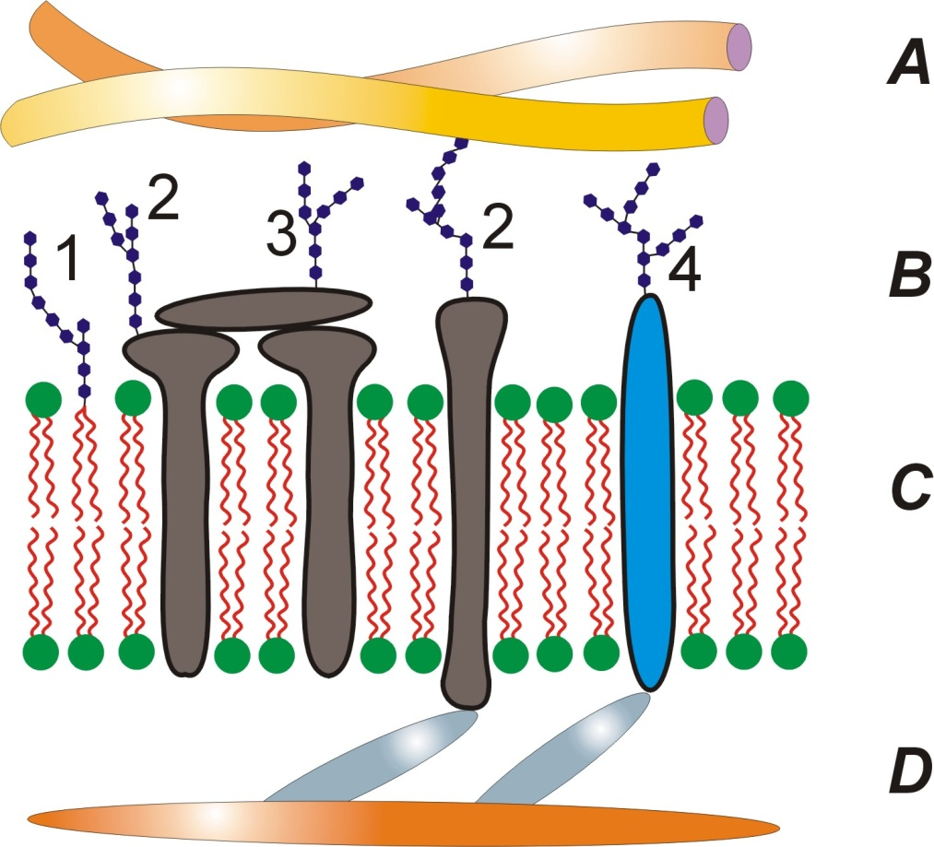
Glykolipidy
DGDG - digalaktosyldiacylglycerol
Notes:
http://www.biotechacademy.dk/upload/institutter/bic/sites/biotech%20academy/enzymer/dgdg.png
http://xarquon.jcu.cz/edu/zbb/prednasky/05surface/images/cellsurface.jpg

Slide 2
Fosfolipidy
Notes:
http://www.nature.com/scitable/content/ne0000/ne0000/ne0000/ne0000/14706174/U3CP1-1_Phospholipid.jpg

Slide 3
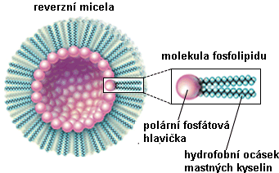
Micely
Notes:
http://vydavatelstvi.vscht.cz/knihy/uid_es-002_v1/figures/micela.01.jpg
http://www.aetherwavetheory.info/images/biology/evolution/reverzn%C3%AD_micela.gif

Slide 4
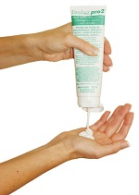
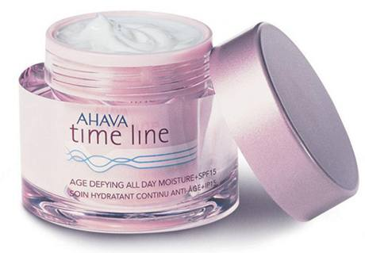
emulze
Notes:
http://www.desinfekce.sk/uws_images/emulze.jpg
http://i.idnes.cz/09/061/gal/VES2b7f58_Time_Line_od_znacky_Ahava.jpg

Slide 5
Dvojvrstvy
Notes:
http://upload.wikimedia.org/wikipedia/commons/thumb/2/29/CellMembraneDrawing_numbered.jpg/500px-CellMembraneDrawing_numbered.jpg

Slide 6
Transporty
Notes:
http://www.botanika.borec.cz/schemata/transport.jpg

